Slide 1
＊Take a seat wherever you like.
＊Bring drinks and snacks
＊Relax and enjoy

Slide 2
* When you have nothing to do?
* When you are talking to your friends?
* When you are surrounded by nature?
* When you are bathing?
* Or when you are in the bathroom?
When do you come up
with new ideas?

Slide 3
You want to have a “talk,” Where and When?
* When you walk past?
* When you are talking about other topics?
* When you go out drinking?
* When you are at a spa together?
* Or when you are at the café?

Slide 4
You can exchange live ideas and create new ideas because we offer a place to engage in small talk as you would at a café.

Slide 6
The difference between conventional lectures and Care Café
At conventional lectures
* Only the lecturer provides information
* Nothing sticks in your memory later
* It's difficult to ask questions
* Current issues will never be solved
* The audience's opinions are not reflected
* You cannot make friends
* You can acquire a lot of information
* You gain knowledge
* You are free to ask as many questions as you like
* You can help solve current issues
* You can appreciate different points of view.
* You can built face to face relationships.

Slide 7
Fun conversation
Equal relationships
Open minded
opinions
Café effects

Slide 8
Building face to face relationships Offering place where you can talk about different issues

Slide 9
Chat1
Free discussion
about the theme
Chat2
The table host Introduces Chat 1 to each table, followed by discussion of the theme
Chat3
Share your opinions
with the room
How to run

Slide 10
MVS
most valuable soudan/shitsumon

Slide 11
“Great questions”
“Thank you for the talk”
“Precise point”

Slide 12
Special gift for the MVS

Slide 13
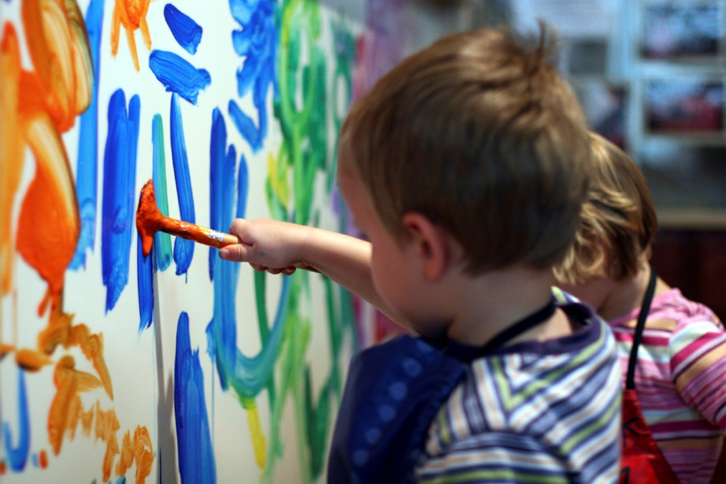
Big piece of paper
* Start writing (drawing)!
* Write anything you want
- Contents of the conversation
- Any ideas
- Any scribbles or doodles

Slide 14
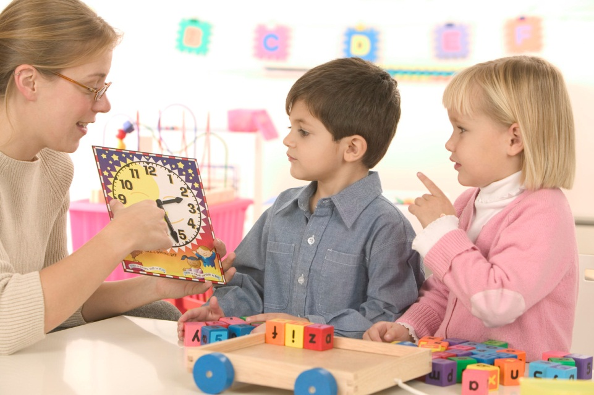
The table host
* 1 table host per table
* The table host should stay at the table
- He/she does not have to lead the conversation.
- He/she explains the Chat 1 theme at Chat 2
- It would be a good idea to offer topics.

Slide 15
Raise your hands

Slide 16
Theme
“Dementia”

Slide 17
-introduction
Partner
Self
＊ Interview the person sitting next to you, your partner, for a minute
＊ Introduce your partner to the others at the table
What to introduce
＊ Name and occupation
＊ “”

Slide 18
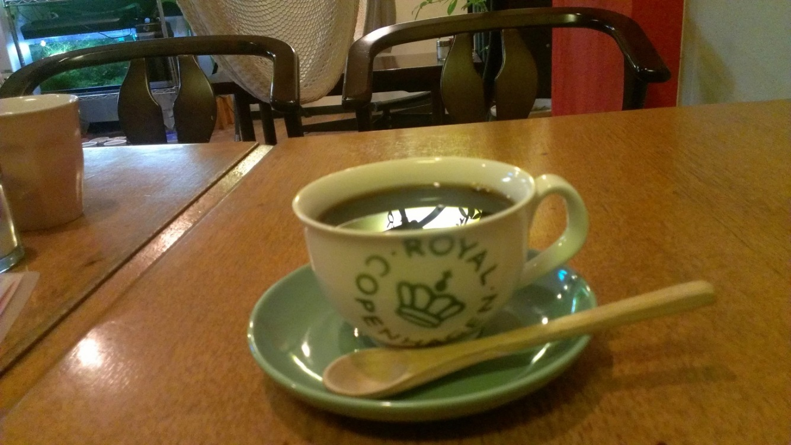
Chat 1
Free discussion about the theme

Slide 19
* Move to another table, the table host stays at the same table
* Don’t forget to bring
－Coffee or other drinks
－dessert or snacks
－your smile
* Introduce yourself

Slide 20
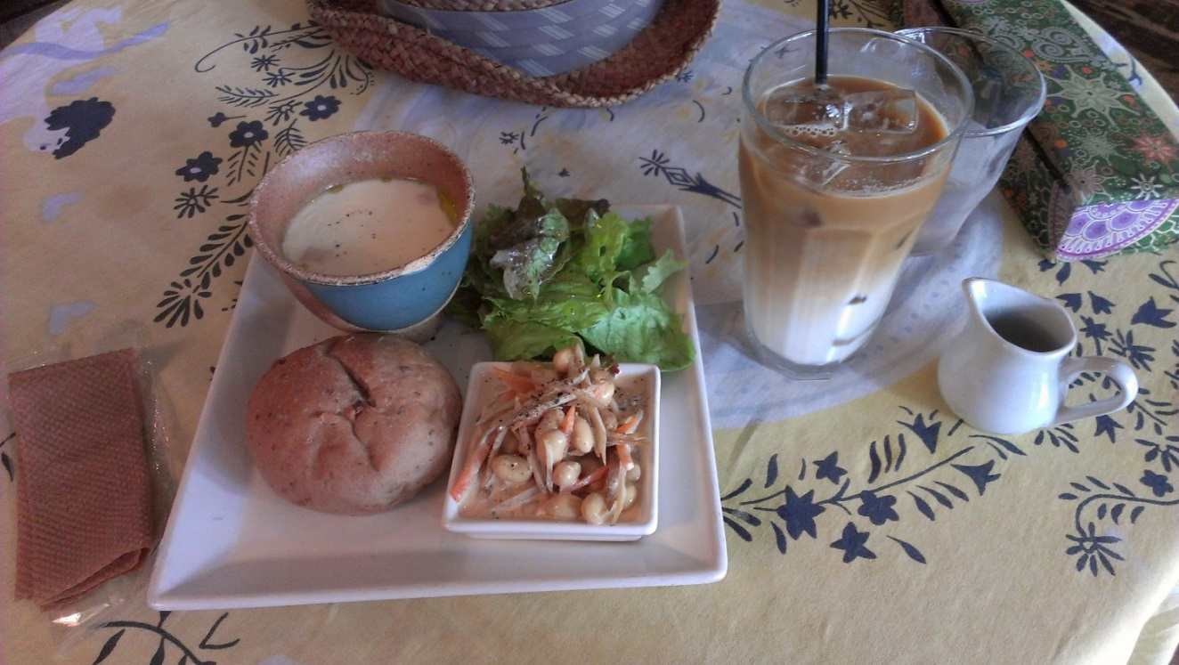
Chat 2
The table host Introduces Chat 1 to each table, followed by discussion of the theme

Slide 21
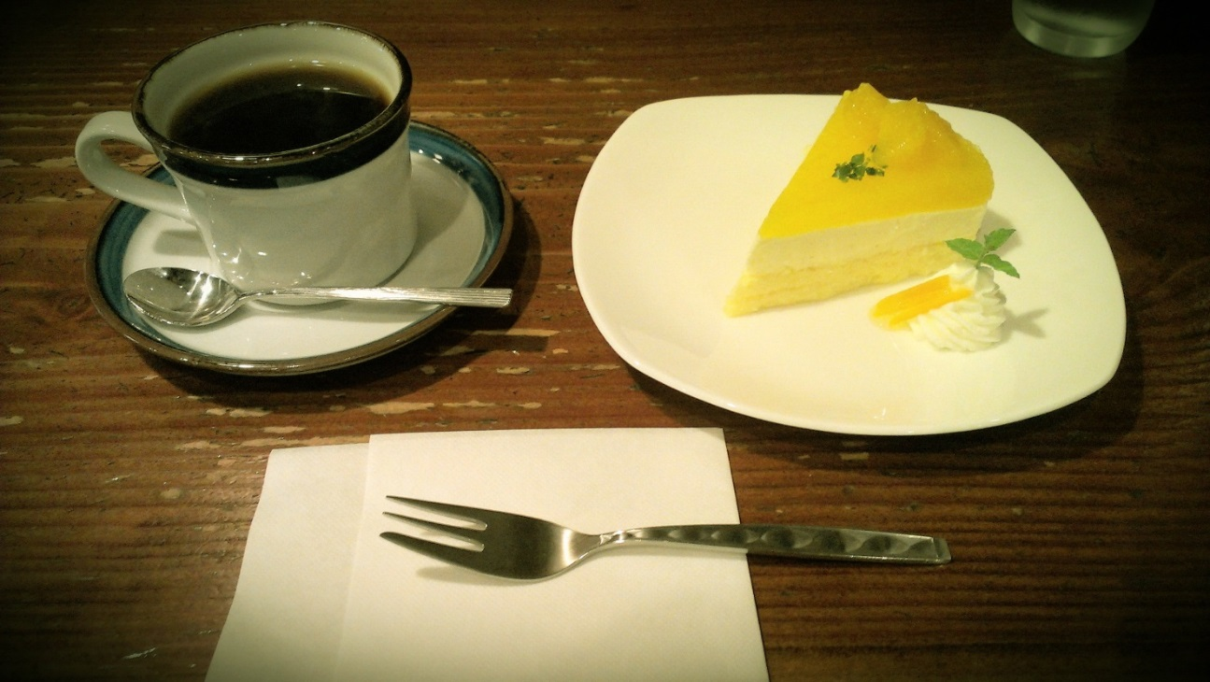
Chat 3
Share your opinions
with the room

Slide 22
MVS
most valuable soudan/shitsumon

Slide 23
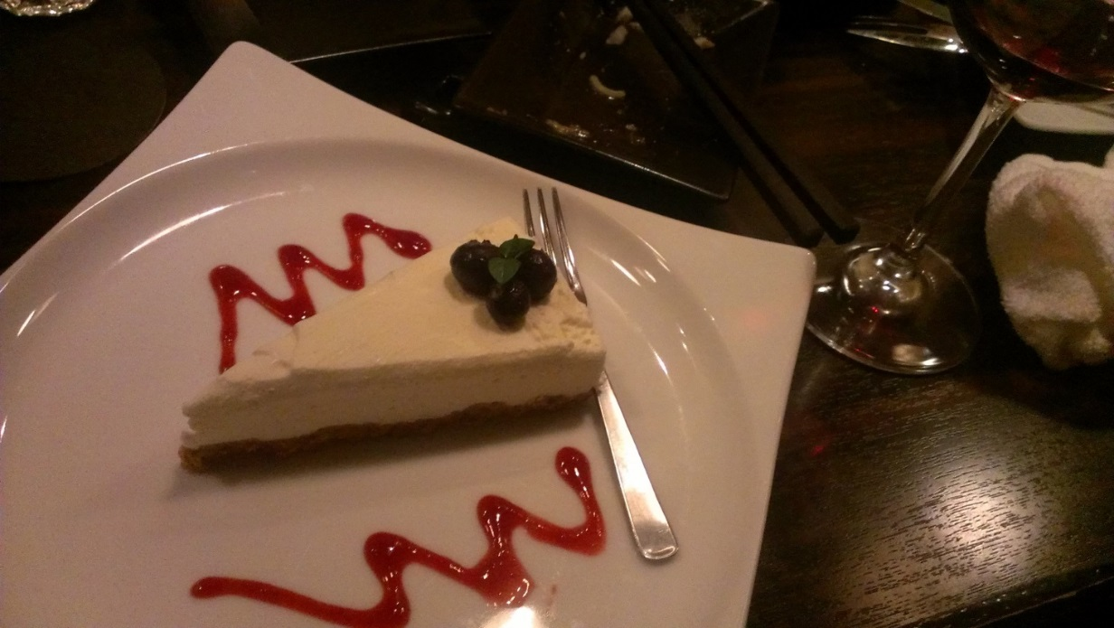
Chat 4
Free time

Slide 24
Favor from Care☆Cafe
Join our mailing list (Leave your business card or contact information)
Notify us in advance about any Care Café related photo usage due to privacy issues.
Help us to clean up and return the items we used at Care Café.
Let us tell you the information about the next Care Café.
Let us know of any events you would like to advertise.
Spread the word about us online or at work.
Take any leftovers home.
Donations are welcome to cover running costs such as rent and materials.
Thank you
for your attendance and participation.

